Slide 1
House Rent Prediction
Divyanshu
Neeraj
Abhivarun
Sr University

Slide 2
Why Rent Prediction Matters
The significance of rent prediction for landlords and tenants
Impact on budgeting and financial planning
The significance of rent prediction for landlords and tenants
Impact on budgeting and financial planning
Minimizing rental disputes
Enhancing property management
Supporting housing market research
Facilitating informed investment decisions

Slide 3
Why Rent Prediction Matters
01
02
Impact on
Budgeting and financial planning
The significance of rent prediction for landlords and tenants
Introduction
A warm welcome to our House Rent Prediction presentation
we will explore the world of predicting house rents.
Let's dive in!!!
03
04
Minimizing
Rental disputes
Property
management

Slide 4
Data Collection
Gathering data for rent prediction
Sources of data (real estate websites, property management software, surveys, etc.)
The importance of data quality and completeness
Effective data collection ensures a robust foundation for the rent prediction model.
Data may include property details (size, location, amenities), historical rent prices, economic indicators, and demographic information.

Slide 5
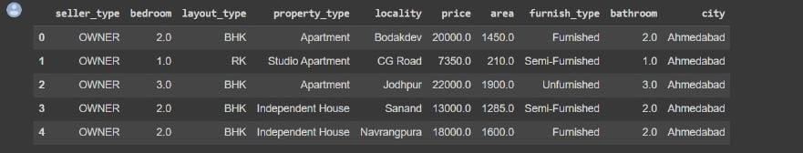
Data Set

Slide 6
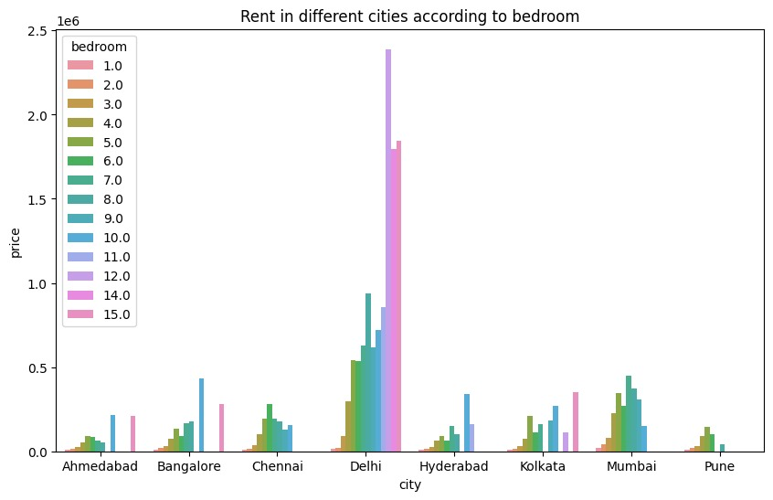
Statistical Graphs

Slide 7
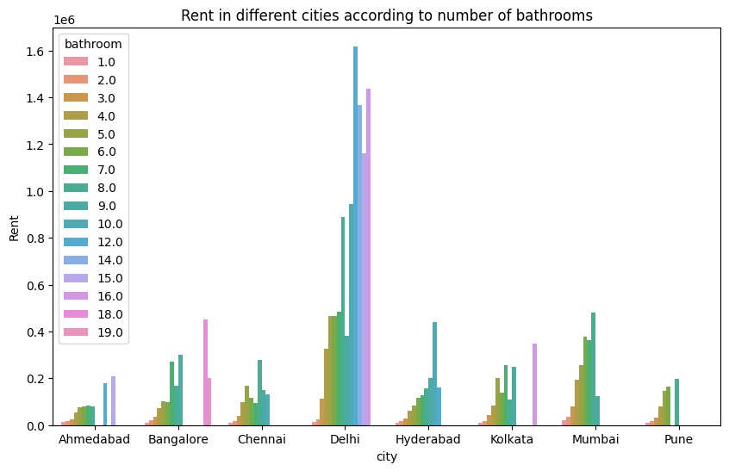
Statistical Graphs

Slide 8
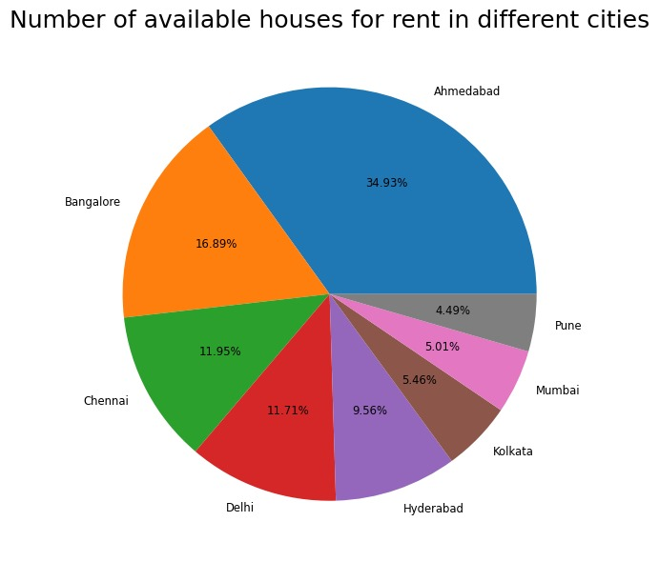
Statistical Graphs

Slide 9
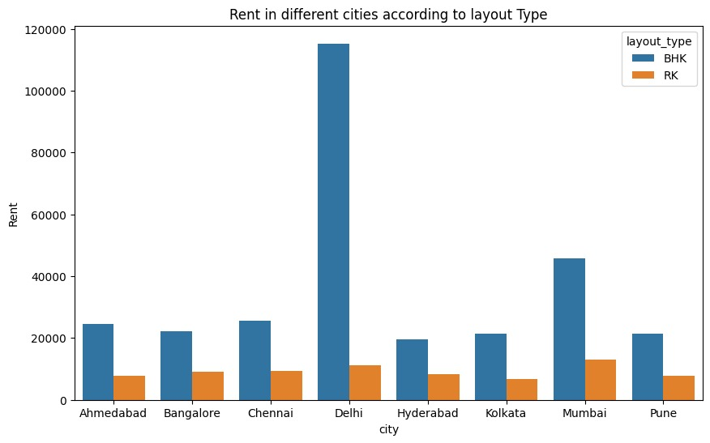
Statistical Graphs

Slide 10
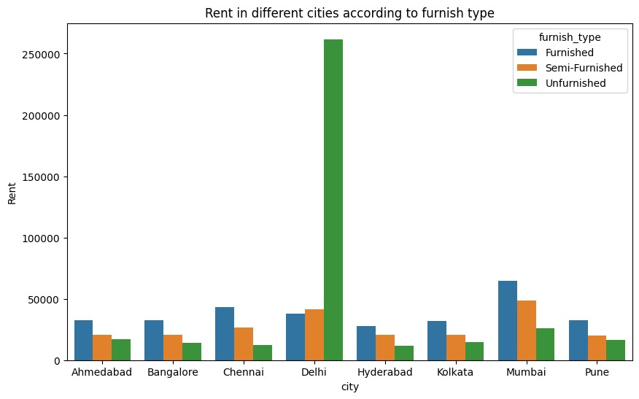
Statistical Graphs

Slide 11
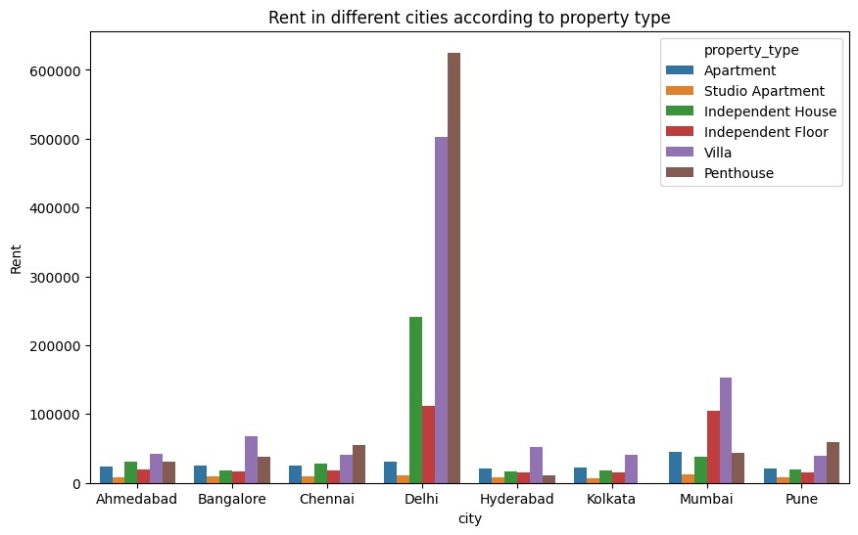
Statistical Graphs

Slide 12
Linear Regression
Linear Regression is a machine learning algorithm based on supervised learning. It performs a regression task. Regression models a target prediction value based on independent variables. It is mostly used for finding out the relationship between variables and forecasting. Different regression models differ based on – the kind of relationship between dependent and independent variables they are considering, and the number of independent variables getting used. There are many names for a regression’s dependent variable. It may be called an outcome variable, criterion variable, endogenous variable. The independent variables can be called exogenous variables, predictor variables.

Slide 13
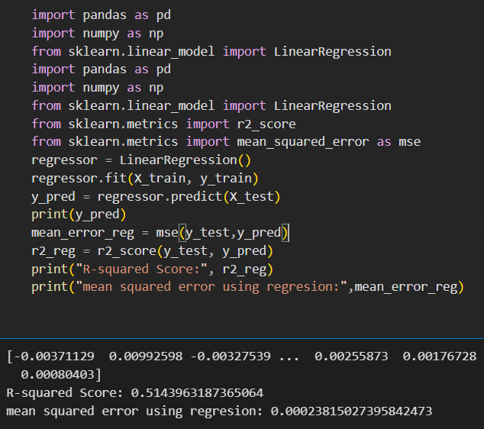
Code

Slide 14
Support Vector Machine
Support Vector Machines are powerful machine learning algorithms used for classification and regression tasks. They work by finding an optimal hyperplane that best separates data points into distinct classes or predicts numeric values. SVMs are known for their ability to handle high-dimensional data and are effective in scenarios with complex decision boundaries. They are widely used in various applications, including image classification, text classification, and bioinformatics.

Slide 15
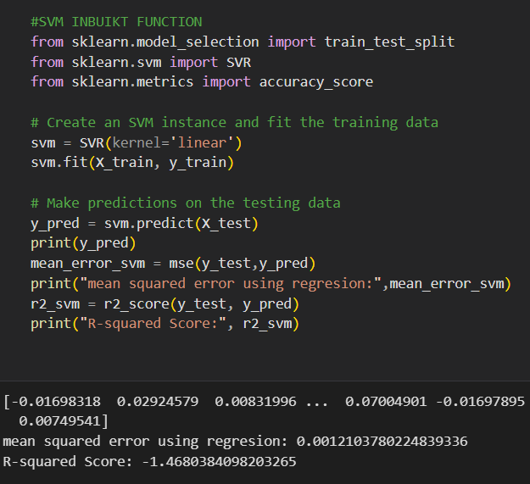
Code

Slide 16
Ridge Regression
Ridge regression is the method used for the analysis of multicollinearity in multiple regression data. It is most suitable when a data set contains a higher number of predictor variables than the number of observations. The second-best scenario is when multicollinearity is experienced in a set.

Slide 17
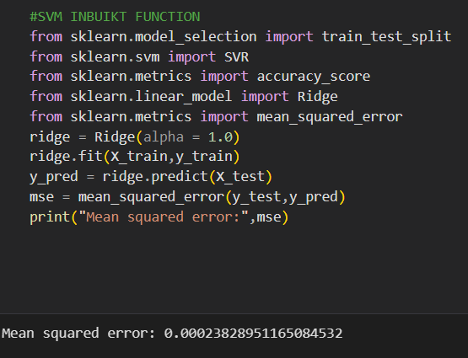
Code

Slide 18
Lasso Regression
LASSO regression, also known as L1 regularization, is a popular technique used in statistical modeling and machine learning to estimate the relationships between variables and make predictions. LASSO stands for Least Absolute Shrinkage and Selection Operator.
The primary goal of LASSO regression is to find a balance between model simplicity and accuracy. It achieves this by adding a penalty term to the traditional linear regression model, which encourages sparse solutions where some coefficients are forced to be exactly zero. This feature makes LASSO particularly useful for feature selection, as it can automatically identify and discard irrelevant or redundant variables.

Slide 19
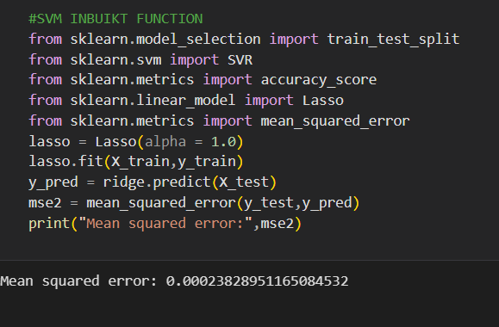
Code

Slide 20
K-Nearest Neighbours
The k-nearest neighbors algorithm, also known as KNN or k-NN, is a non-parametric, supervised learning classifier, which uses proximity to make classifications or predictions about the grouping of an individual data point. While it can be used for either regression or classification problems, it is typically used as a classification algorithm, working off the assumption that similar points can be found near one another.

Slide 21
Code
import pandas as pd from sklearn.neighbors import KNeighborsRegressor from sklearn.model_selection import train_test_split from sklearn.metrics import mean_squared_error # Load the dataset # Split the dataset into training and testing sets #X_train, X_test, y_train, y_test = train_test_split(df.drop('Rent', axis=1), df['Rent'], test_size=0.2, random_state=42) # Create a KNN model knn = KNeighborsRegressor(n_neighbors=5) # Fit the model on the training data knn.fit(X_train, y_train) # Predict the rent on the testing data y_pred = knn.predict(X_test)

Slide 22
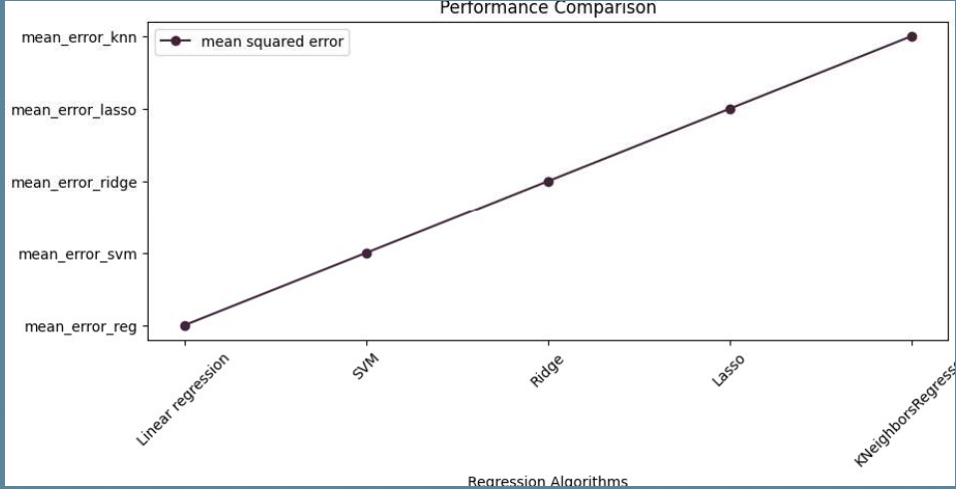
Performance Comaparision

Slide 23
Result
Model Performance: Present key performance metrics such as RMSE (Root Mean Square Error), MAE (Mean Absolute Error), and R-squared to evaluate the accuracy and reliability of the rent prediction model.
Example Predictions: Showcase a few example predictions, demonstrating how the model performs in predicting rent for specific properties. Compare these predictions to actual rent values when possible.
Visualizations: Use charts or graphs to visually represent the model's predictions versus actual rents, highlighting areas of accuracy and potential areas for improvement.
Accuracy and Reliability: Discuss the overall accuracy of the model and its reliability in making rent predictions. Mention any challenges or limitations encountered during the modeling process.

Slide 24
Result
Benefits: Emphasize how accurate rent predictions can benefit various stakeholders, such as landlords, tenants, and property managers, in terms of financial planning, decision-making, and resource allocation.
Future Directions: Briefly mention potential future enhancements or refinements to the model to further improve its predictive capabilities.
Case Studies: If applicable, share specific case studies or real-world examples where the model's predictions have led to better decision-making or financial outcomes.

Slide 25
Conclusion
Recap of key points
Emphasizing the importance of rent prediction
Encouraging further exploration and implementation
Express enthusiasm for the potential benefits that data-driven insights can bring to the rental market.
Thank the audience for their attention and participation in the presentation.

Slide 26
Thank you…

